Slide 1
08: Flushing & Buffers
Dr. Hamish Carr & Dr. Rafael Kuffner dos Anjos

Slide 2

Agenda
Parallel processing
Passing information to openGL
Some optimizations
COMP 5812M: Foundations of Modelling & Rendering

Slide 3

A Problem
Suppose I want to render two surfaces
Each with a different texture
I've avoided this in the first assignment
I only have one texture per object
And only object
And I process primitives immediately
COMP 5812M: Foundations of Modelling & Rendering

Slide 4
The Reality
I add vertices to the queue
A separate thread or threads processes them
Another thread or many rasterises
Another thread (or many) process fragments
We have to deal with read/write order
Assumption: we don't know when it happens
What can go wrong?
COMP 5812M: Foundations of Modelling & Rendering

Slide 5
Out-of-Order Processing
A general problem with parallelism
One processor generates data
Another processor consumes it
If all data is passed explicitly, no problems
But if any data is implicit, big problems
For example, two textures
COMP 5812M: Foundations of Modelling & Rendering

Slide 8

Solutions
1. Keep everything serial (not happening)
1
2. Pass everything as part of data (expensive)
2
3. Keep everything in state (wrong output)
3
4. Flush the pipeline whenever state changes
4
Any state change triggers a flush
glEnable(), glDisable(), &c., &c., &c.
COMP 5812M: Foundations of Modelling & Rendering

Slide 9

glFlush() Call
Stalls or suspends the calling thread
Invokes TransformVertex() until queue empty
Then RasterisePrimitive() until queue empty
Then ProcessFragment() until queue empty
Releases the calling thread
Net result: very expensive
So minimise state changes in your pipeline
COMP 5812M: Foundations of Modelling & Rendering

Slide 10
Calls that Flush
Set/modify textures
Set/modify matrices
Changes to a render flag
Changes in lighting
Changes to render attributes

Slide 11
Attributes
Normally do not trigger flush
Because they are payload
Data passed with the vertex / fragment
The more attributes, the higher the cost

Slide 12
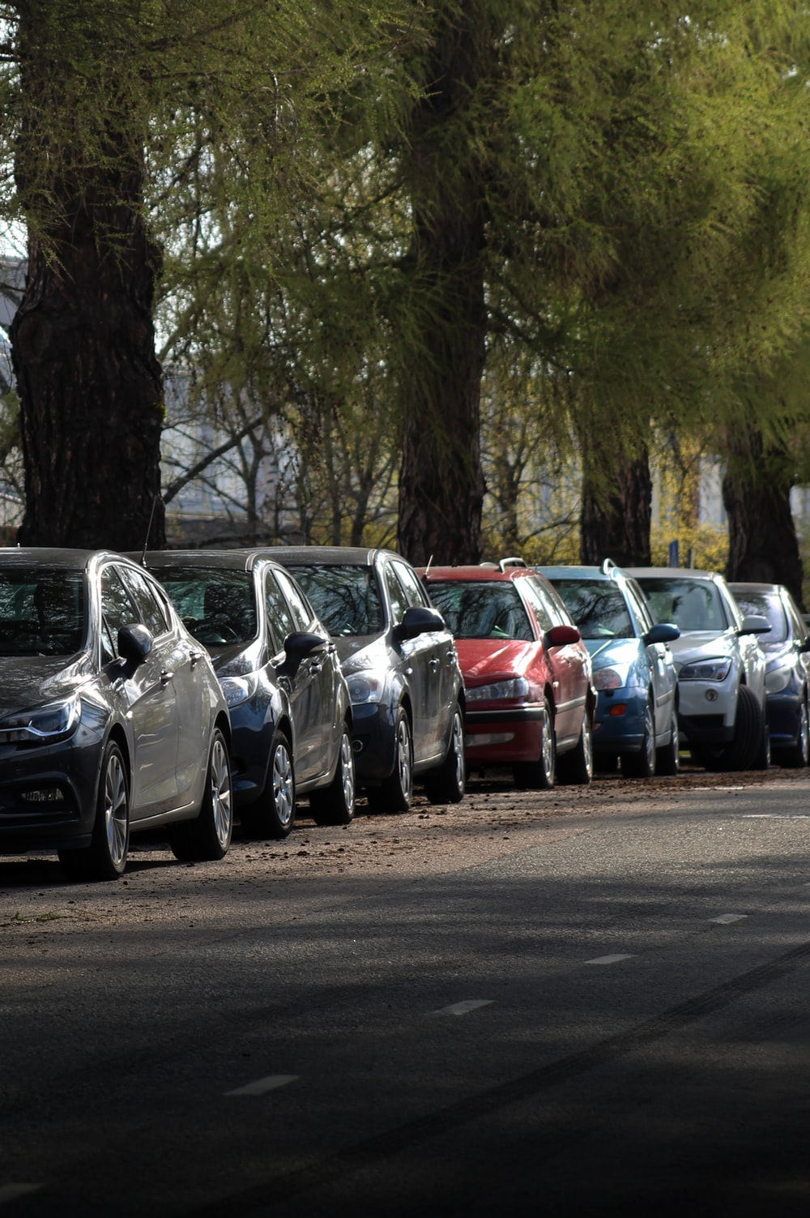
Direct Mode
So far, we have used direct mode
We have called glVertex() for each vertex
Which adds function call overhead
And sends small packets down the video bus
And last year, we computed vertex positions
For example, rendering a sphere
Every frame, we called trig functions
COMP 5812M: Foundations of Modelling & Rendering

Slide 13
Improvements
Pre-compute vertex attributes (inc. position)
Treat vertex attributes as data (I/O)
Reuse vertices
Cache previous vertices
Group vertices together & process in bulk
Transfer attributes to texture
Tessellate higher order surfaces on the fly
COMP 5812M: Foundations of Modelling & Rendering

Slide 14

1. Pre-computing Vertices
Never, ever compute vertices every frame
Unless you absolutely have to
Compute once at beginning of run
Store them in memory
If needed, update them on a separate thread
Note: this combines with other strategies
COMP 5812M: Foundations of Modelling & Rendering

Slide 15

2. Vertex Attributes are Data
If you can pre-compute, you can save to disk
Store all your vertices on disk
Read them in during load screen
Then use them
Paradigm: triangle soup
A disk file which lists vertices per face
But on average, each vertex used 6 times
COMP 5812M: Foundations of Modelling & Rendering

Slide 16

3. Re-use Vertices
Ideally, we transform each vertex once
Store it in memory, then reuse it
Three major variants:
library support for loops & strips
caching previous results
transfer to compute shader
COMP 5812M: Foundations of Modelling & Rendering

Slide 17
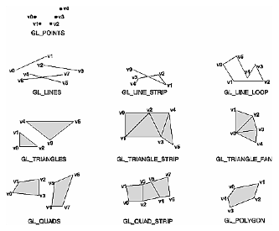
(Old) Face Improvements
Display lists – save bandwidth, cache on GPU
Implicit vertex reuse
Line Strips & Loops
Triangle Fans & Strips
Quads, Quad Strips
Polygons

Slide 18
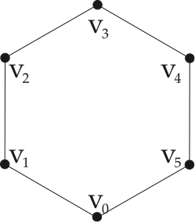
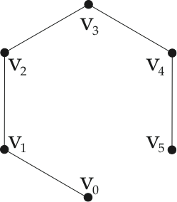
Lines, Strips & Loops
GL_LINES:
v0v1
v1v2
v2v3
v3v4
v4v5
v5v0
2 v/e
GL_LINE_STRIP:
v0v1
(v1)v2
(v2)v3
(v3)v4
(v4)v5
~ 1 v/e
GL_LINE_LOOP:
v0v1
(v1)v2
(v2)v3
(v3)v4
(v4)v5
(v5)(v0)
~ 1 v/e

Slide 19
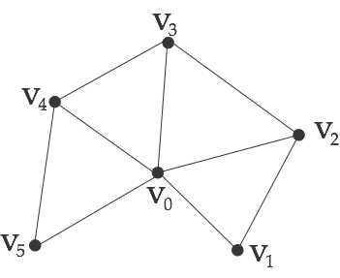
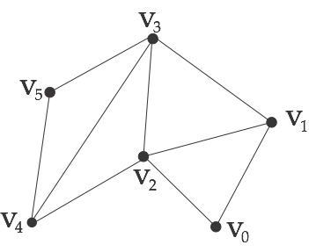
Triangle Fans/Strips
GL_TRIANGLE_FAN:
v0v1v2
(v0)(v2)v3
(v0)(v3)v4
(v0)(v4)v5
~ 1.16 v/e
(degree 6 vertex)
GL_TRIANGLE_STRIP:
v0v1v2
(v2)(v1)v3
(v2)(v3)v4
(v4)(v3)v5
~ 1 v/e
(for long strips)
alternate CW/CCW
NP-hard to find them
easier on regular grids

Slide 20

4. Caching Vertices
Transform stage usually has a vertex TLB
Translation Lookaside Buffer
Stores previously transformed vertices
If no state has changed, uses previous result
Clears the cache whenever the pipeline flushes
Will never be entirely optimal
But reasonably effective (and cheap)
COMP 5812M: Foundations of Modelling & Rendering

Slide 21

5. Vertex Arrays
Store all of the data in an array
Loop through the array to use the vertices
Can implement with:
array of classes
class of arrays
parallel arrays
interleaved arrays

Slide 22
Vertex Arrays
Replace individual glVertex() calls - Pass entire arrays to library
Push loop through vertices into library call

Slide 23
GL Vertex Arrays
Notice, it just passes a pointer
So OpenGL has a CPU-resident loop
iterates through the array you passed it
makes the glVertex() calls for you
can optimise to reduce the number of calls
Essentially, this is what an .obj file is for
COMP 5812M: Foundations of Modelling & Rendering

Slide 24
5a. Pretransformed Vertices
Do all of the matrix transforms on CPU
Once for each vertex
Then use a vertex array
Problem: transform stage still transforms them
Unless you write a null transform stage
But very useful for animation / skinning
Where vertices have weighted transforms
COMP 5812M: Foundations of Modelling & Rendering

Slide 25
5b. Vertex Buffers
An improvement on vertex arrays
Instead of passing a pointer to the library, pass a pointer for bulk memory transfer directly to GPU
Vertex array loop on GPU
Driver must have a standardized version
Adds some overhead
COMP 5812M: Foundations of Modelling & Rendering

Slide 26
Working with Vertex Buffers
Where is it?
How do we allocate it?
How do we transfer data to it?
How do we connect it into the pipeline?
How does the shader access it?

Slide 27

Possible Locations
A vertex buffer can be:
In main RAM
In shared (mapped) memory
In host-accessible VRAM
In GPU-only VRAM (fastest)
The question is really how do we transfer it
COMP 5812M: Foundations of Modelling & Rendering

Slide 28

Transferring the Data
We want the data to end up in fast VRAM
So we will have to copy it twice:
Once into CPU-accessible VRAM
Call this the staging buffer
Then into GPU-only fast VRAM
The actual vertex buffer
COMP 5812M: Foundations of Modelling & Rendering

Slide 29

5c. Vertex Buffer Objects
OpenGL name for one of these variants
A buffer on GPU + routines for transfer
Then bulk transfer vertices & attributes
I.e. you skip the library entirely
Just invoke a memory transfer
Which requires O/S support
COMP 5812M: Foundations of Modelling & Rendering

Slide 30
5d. Bulk Shader Transform
The pipeline assumes streamed vertices
Processes them one at a time
Instead, take a vertex buffer on the GPU
Transform each vertex (same as CPU)
Then feed into front end of pipeline
And set transform stage to null
But why do we then need a transform stage?

Slide 31

5e. The Future????
Skip the entire pipeline
Write your own render engine front to back
Just embed it in a compute shader
Emit the frame directly
Requires access to hardware support
Eg frame buffer locking
COMP 5812M: Foundations of Modelling & Rendering

Slide 32
6. Attribute Textures
Most attributes of a surface are passed down (E.g. diffuse albedo (RGB))
So why copy it from queue to queue?
Store it in a texture and use only from the fragment shader
Using the uv coordinates to look it up
Minimises the pipeline cost

Slide 33
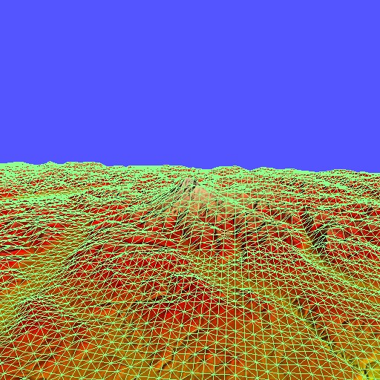
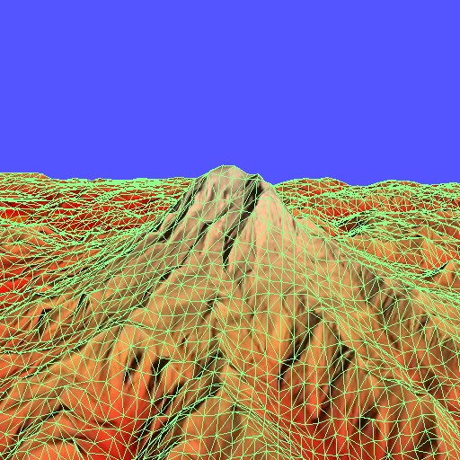
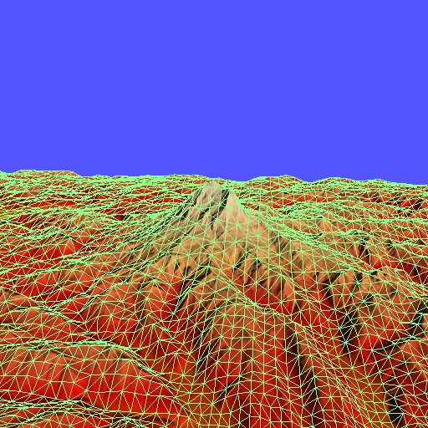
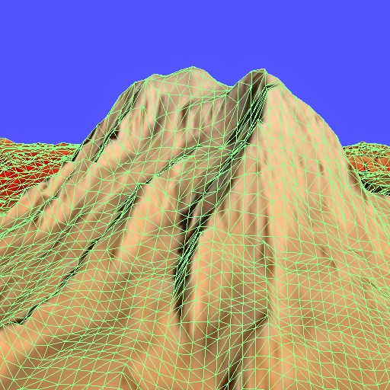
7. Surface Tessellation
Objects designed with higher-order surfaces
Then converted to triangles & stored on disk
Why not just pass the higher order surface?
Then tessellate at runtime?
Generating normals, &c. on the fly
Beginning to be very important
As GPU horsepower has increased

Slide 34
Images by
S2 Drew Beamer
S8 Curology
S11 Anne Nygård
S12 Kaizen Nguyễn
S15 Sigmund
S19 Timo volz
S26 Honey Yanibel Minaya Cruzs
S27 Rose box
S30 FLY:D
On unsplash.com
S32: visualization library v1.0.3

